Slide 1
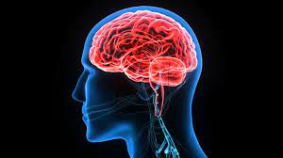
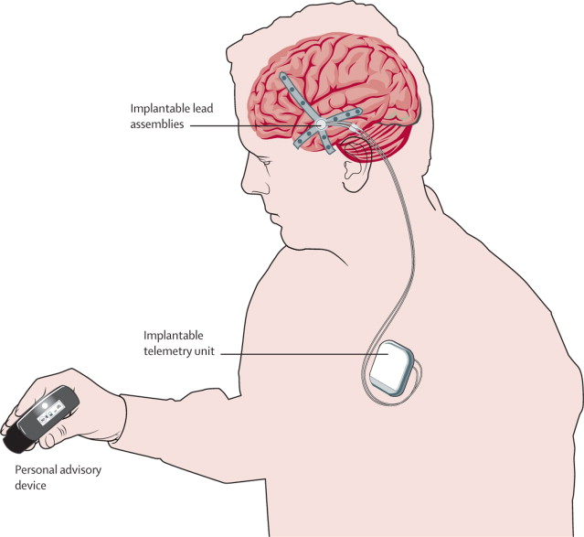
EpiTech: Developing Epilepsy Care with Implantable device
GROUP-2 MARIAM KHAN FNU SAHRASH FATIMA LIKHITHA KANTIPUDI VENU MADHAV PENTALA VEERA VENKATA SATYAVATHI SURAPUREDDY

Slide 2


OBJECTIVES:
Create a device that can be implanted to monitor brain activity continuously.
Incorporate machine learning within the device to detect seizures as they happen.
To test notification systems that alert caregivers and medical professionals during seizures.
To ensure the security of the implanted device in the long-term.
Project Sponsor: Zeyana Hamid
Stakeholders: IU Health
Time Frame: 02/02/2024-04/30/2024

Slide 3
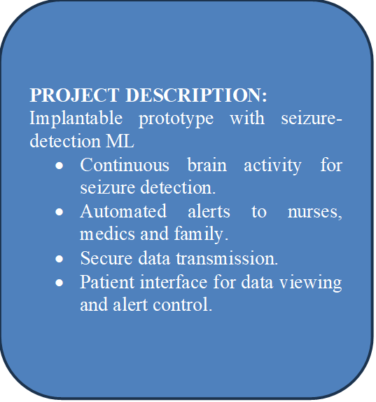
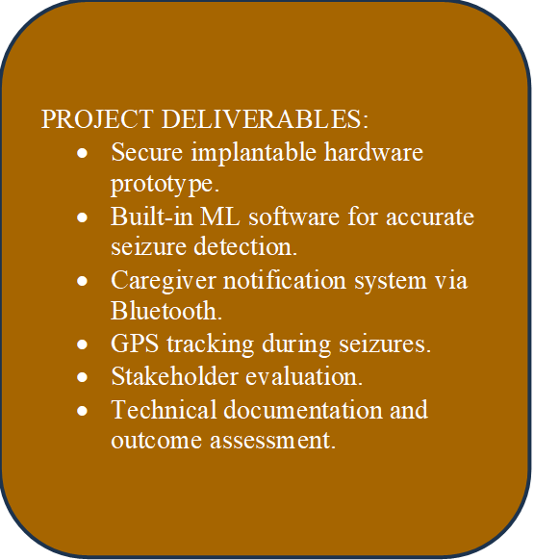
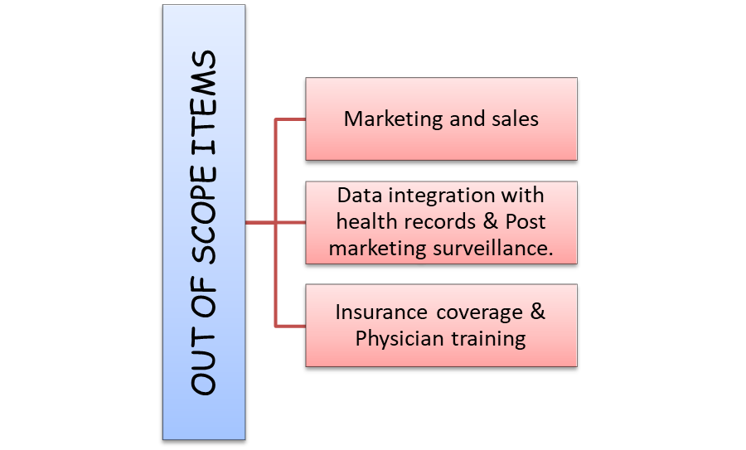
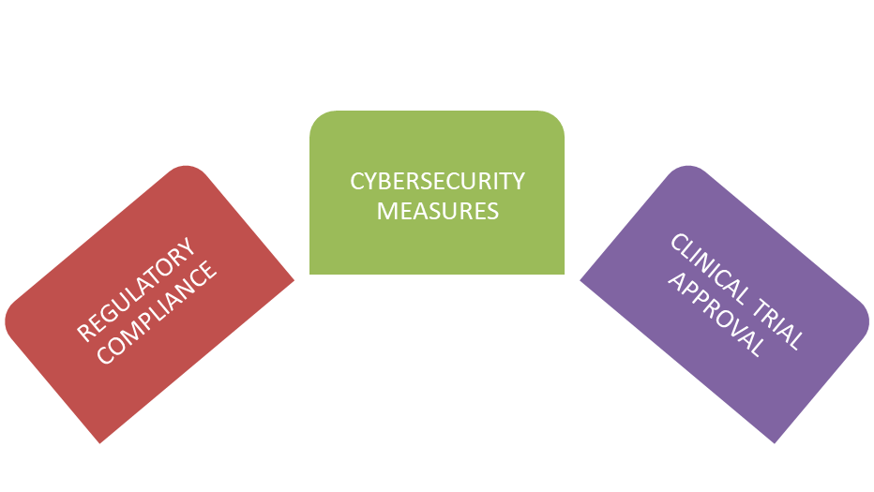


Slide 4
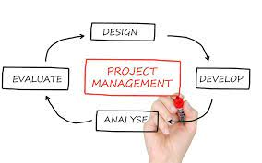
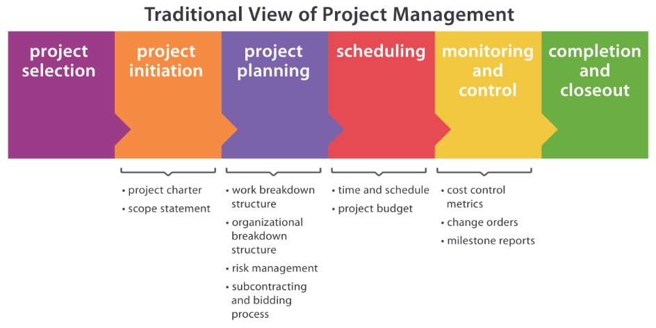

Slide 5

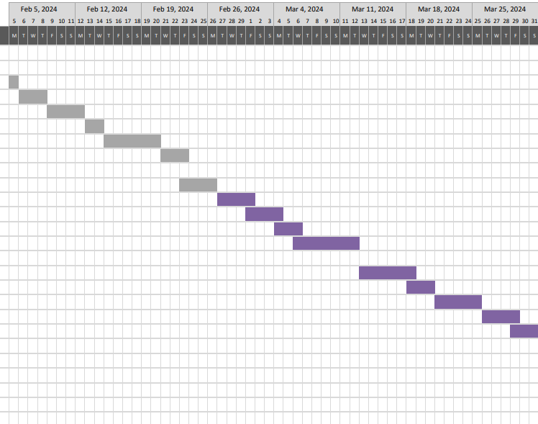
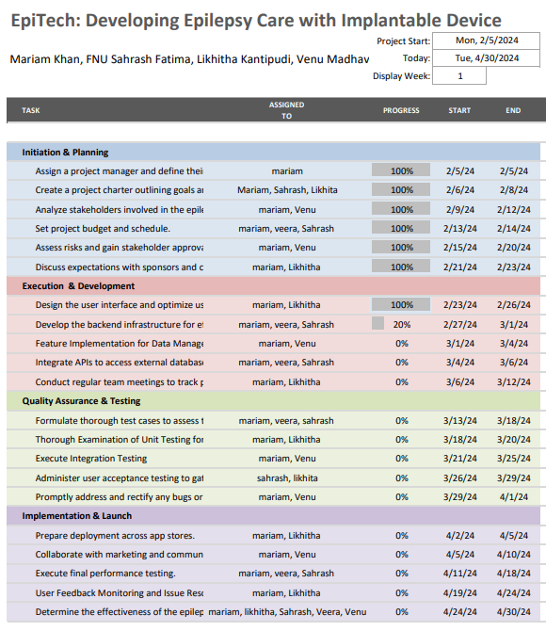

Slide 6

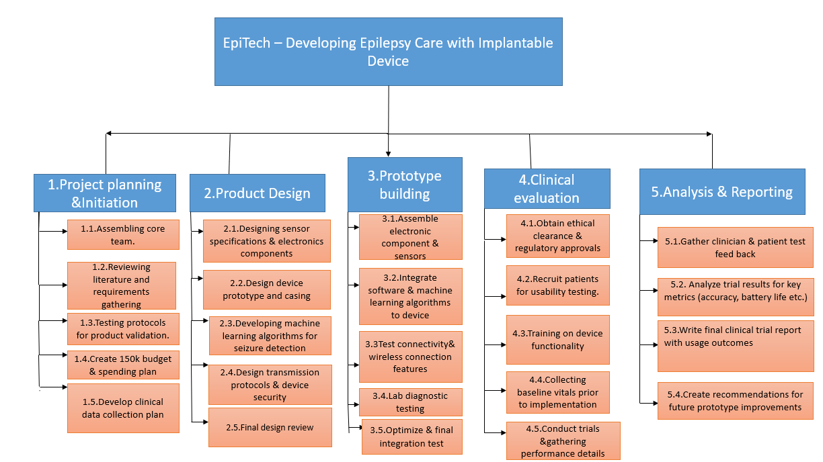
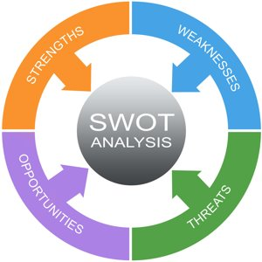
WORK BREAKDOWN STRUCTURE:

Slide 7

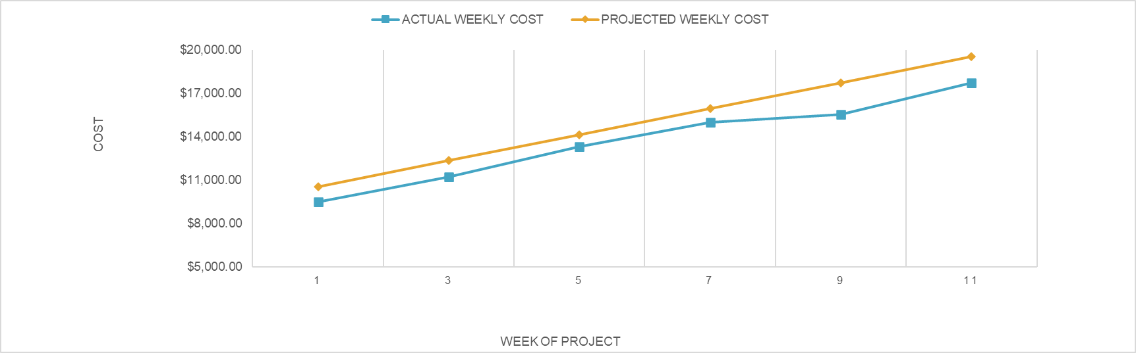
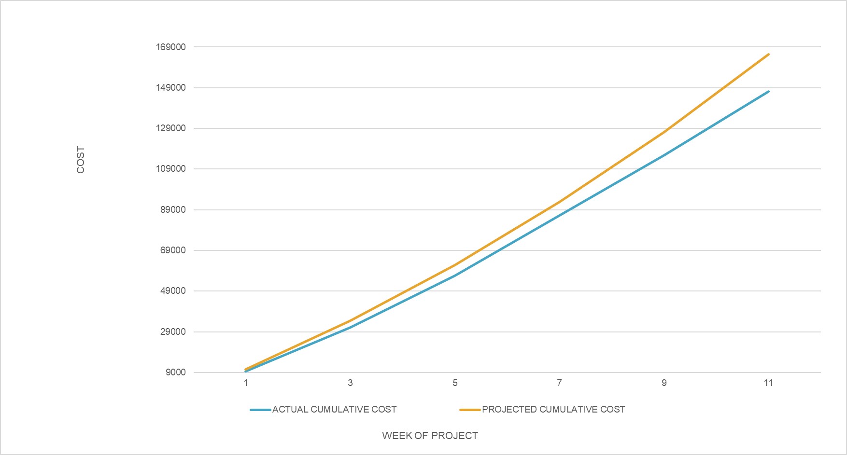
ESTIMATED COSTS: $170,000 ACTUAL COSTS:
$150,000

Slide 8
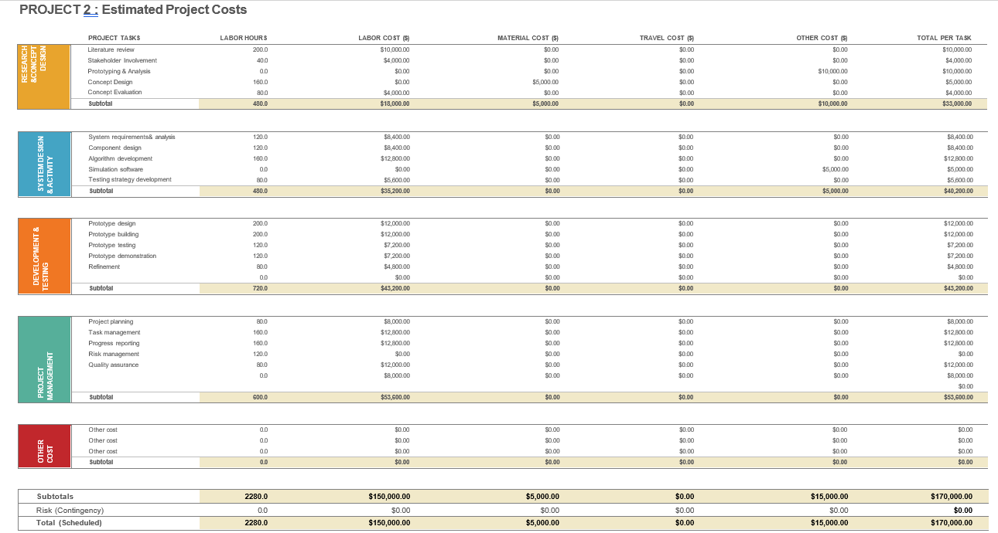

Slide 9
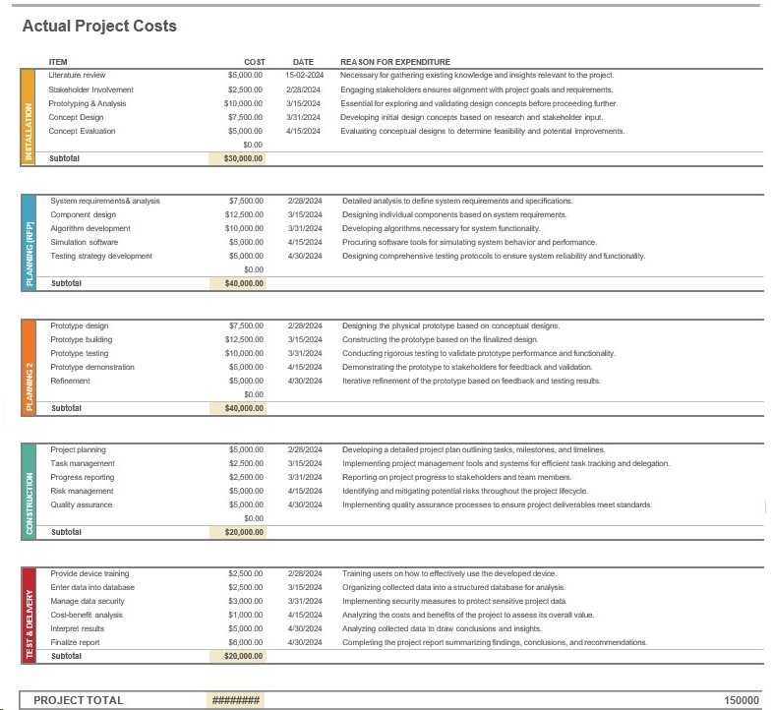

Slide 10

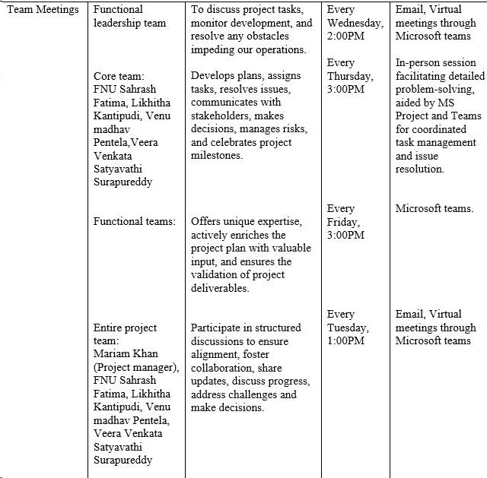



Slide 11

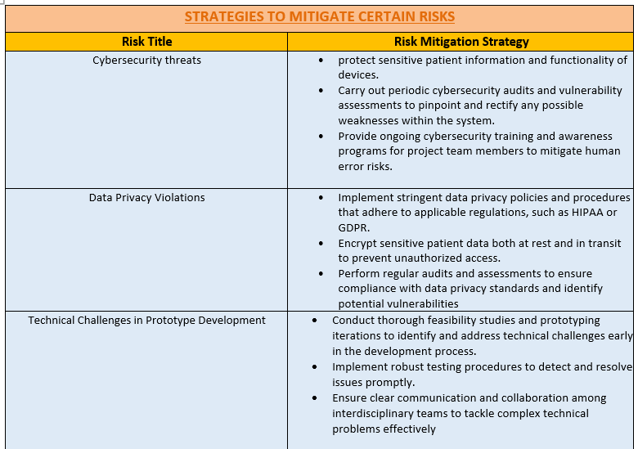


Slide 12

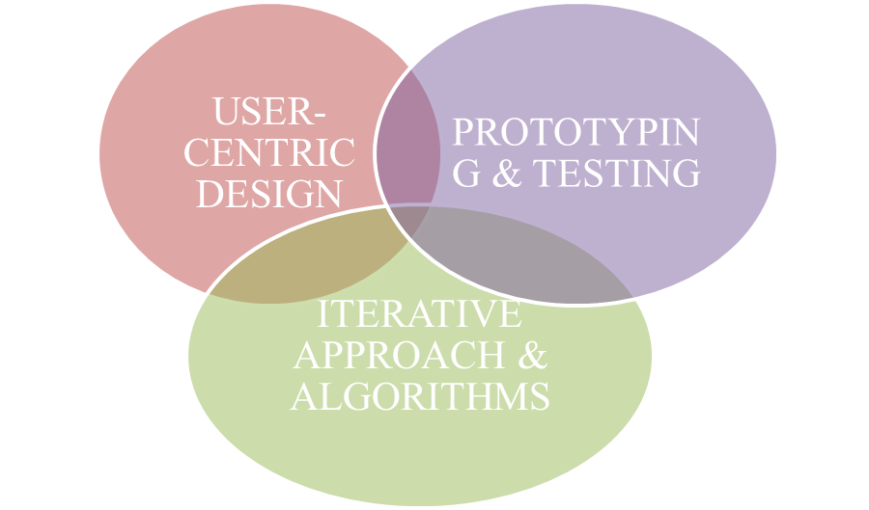




Slide 13


Insights for future projects:
Identifying critical needs and collaborating with the expertise to tackle complex challenges.
Multi-disciplinary collaboration & implementing user-centric design principles.
Strengthening stakeholder management.

Slide 14


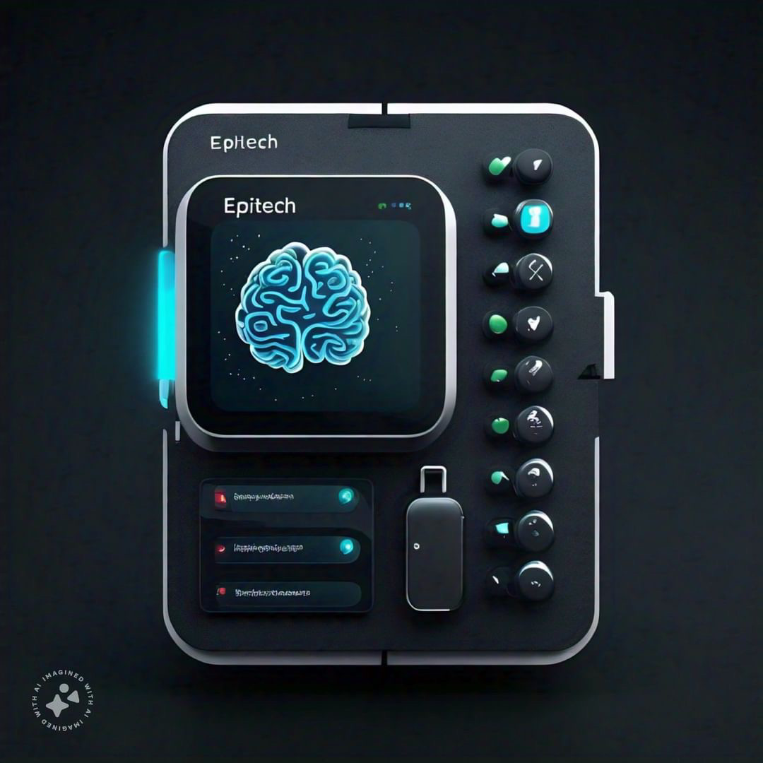
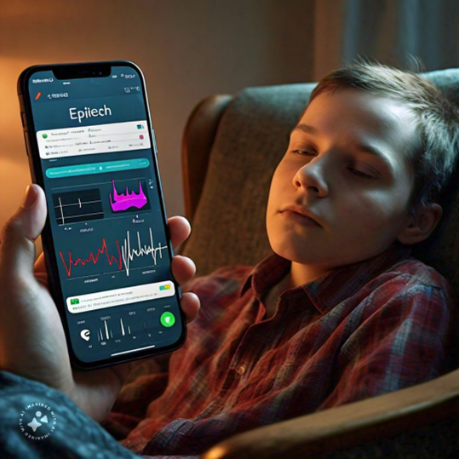

Slide 15
Real-Time Detection and Long-Term Safety
Strategic Goals for EpiTech Development
Scope Boundary for EpiTech Development
Project Milestones: Validation, Approval, and Demonstration
Project deliverables for EpiTech Development
EpiTech
Critical Project Pillars: Resource, Budget, Time, Quality Testing, Stakeholder management
Risk mitigation strategies
WBS: Initiation & Planning, Product Design, Prototype building, Analysis and report

Slide 16


